Slide 1
Lecture no 04
Van De Graff generator & its application

Slide 2
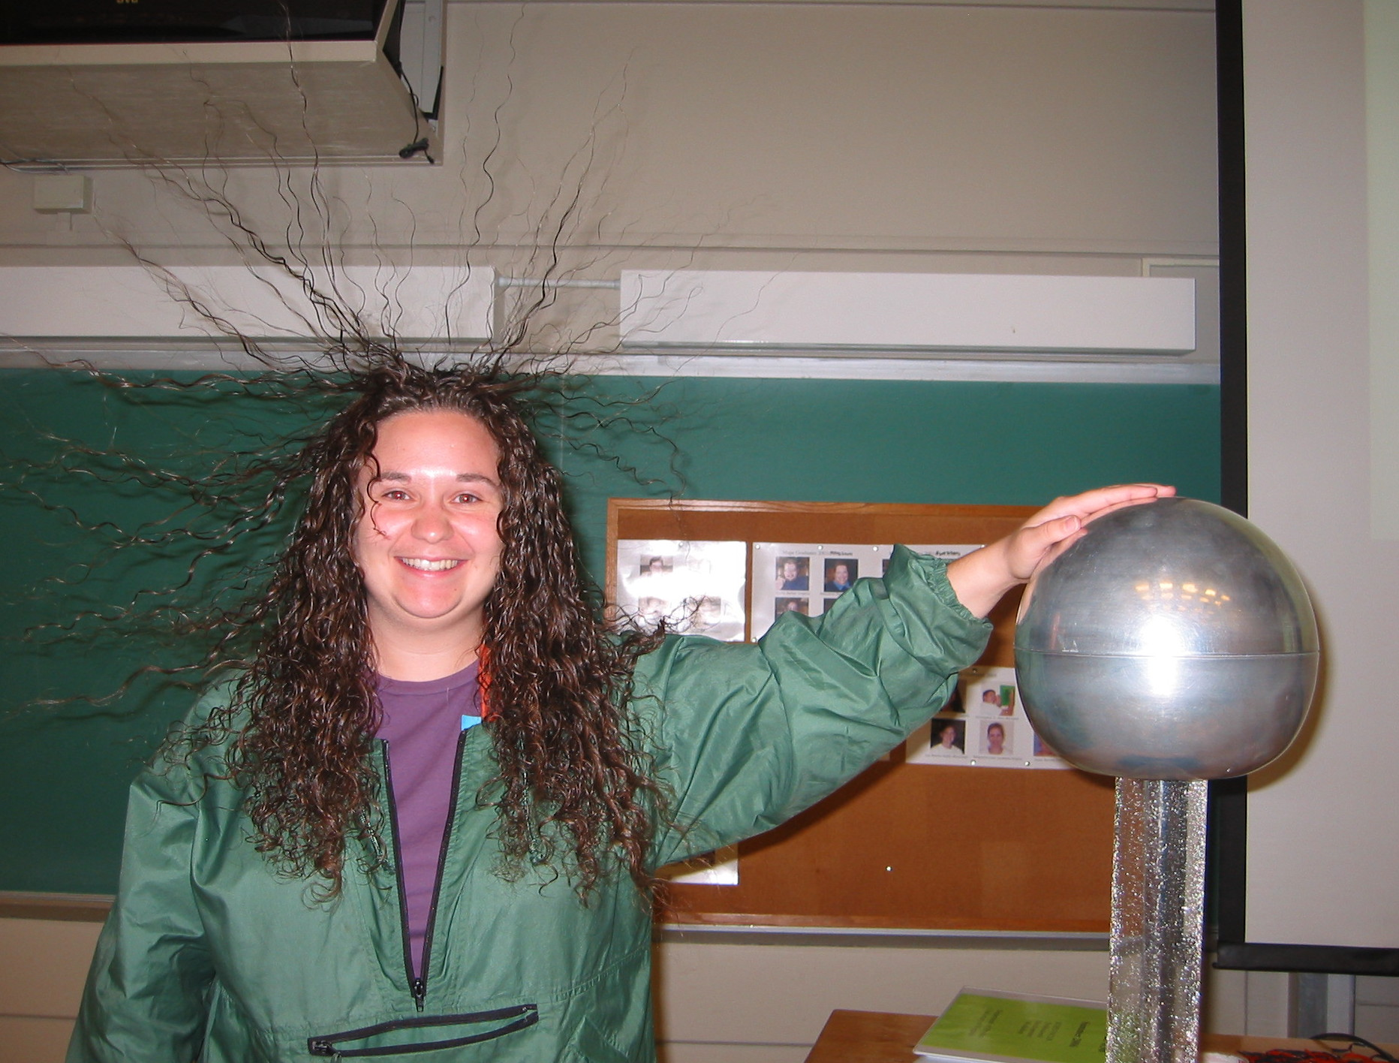

Slide 3
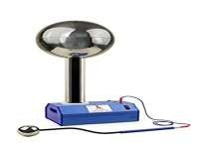
OUTLINE
INTRODUCTION
INVENTION
PRINCIPLE
CONSTRUCTION
WORKING
APPLICATIONS
LIMITATIONS

Slide 4
INTRODUCTION
Van De Graff generator is used to generate high potential differences of near about million volts.
The high voltages generated by the generator can be used for accelerating subatomic particles to high speeds, making the generator a useful tool for fundamental physics research.
SOURCE: INTERNET

Slide 5
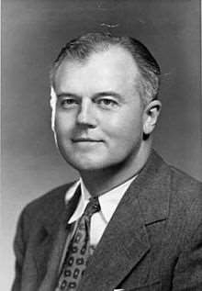
INVENTION
Invented in 1929 by American physicist Robert J. Van de Graff at Princeton University, with help from colleague Nicholas Burke.
SOURCE: INTERNET

Slide 6
PRINCIPLE
Uses two principles of Electrostatics
Corona Discharge :- Discharging action of sharp points, i.e., electric discharge takes place in air or gases readily, at pointed conductors.
If the charged conductor is brought in to internal contact with a hollow conductor, all of its charge transfers to the surface of the hollow conductor and scatters uniformly over it no matter how high the potential of the latter may be.

Slide 7
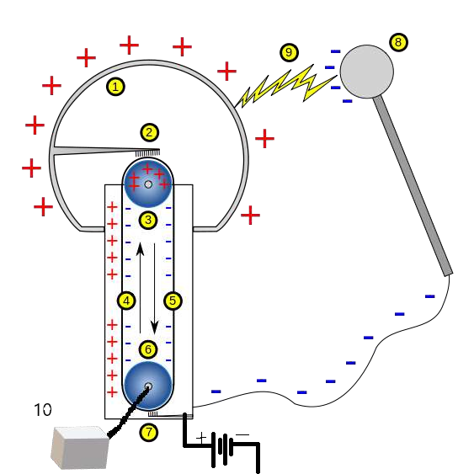





CONSTRUCTION
1 Hollow metal sphere
² Upper electrode
³ Upper roller (metal)
⁴ Side of the belt with positive charges
5 Opposite side of the belt with negative charges
6 Lower roller
7 Lower electrode (ground)
8 Spherical device with negative charges, used to discharge the main sphere
9 Spark produced by the difference of potentials.
¹ Motor which rotates the lower roller.
0

Slide 8
WORKING
The generator uses a plastic pulley at the lower end of the machine, attached to an electric motor. A rubber
belt passes over the pulley. As the pulley turns, rubbing occurs; the pulley acquires negative charges while the
inside surface of the rubber belt (in the vicinity of the plastic pulley) acquires an equal amount of positive charge. The outsid surface of the rubber belt acquires an equal amount of negative charge by induction. An
electrode, in the form of a comb or brush, is provided to drain away these negative charges from the outside
surface of the rubber belt to the "ground." A similar comb (electrode) is provided at the upper end where it will provider a path for positive charges to be taken to the collector dome. The plastic pulley retains the negative charges that it acquired.
Positive charges stay on the inside surface of the belt and travel upwards as the belt moves up. At the top, it
runs over a metallic pulley (aluminum) which picks up these positive charges and retains them. Free electrons
from the metallic pulley flow on the electron-deficient belt and are carried down to the plastic pulley. As the belt
keeps running, more charges are deposited on both pulleys, resulting in heavy buildup of charges on each.
Soon this buildup reaches ionization intensity in the vicinity of the two comb assemblies and a large number of
positive and negative charges are generated. The positive charges are transferred to the collector dome by the
upper comb and the negative charges are drained to the ground by the lower comb. The belt plays an important role in transporting negative charges from upper to lower comb and positive charges (on other half of the belt) from lower to upper comb.

Slide 9
Once on the metallic collector dome, the positive charges spread out due to electrostatic repulsion and
become uniformly distributed because of the dome's spherical shape. The buildup of positive charge on the
dome continues until ionization intensity is reached. This is the equilibrium state and limits the quantity of
charge that the generator can place on its dome. It is measured in volts. Once this limit is reached, the air between dome and lower housing gets ionized and a discharge with sparka.

Slide 10
APPLICATIONS
It is use to creat highg potential of a range of few million volts.
Used to accelerate projectiles like proton, deuteron etc. to carry out different nuclear reactions.
In medicine, such beams are used to treat cancer.
Used to study collision experiments in physics.

Slide 11
LIMITATIONS
It produces very low intensity of current as compared to voltage.
Maintenance and construction is costly and bulky.
For air, a maximum of 3 million volt can be generated as after that air will ionize.
It cannot accelerate neutral particles.

